Slide 1

Predicting Passenger Booking Likelihood
By Mark Coty
https://github.com/markcoty/markcoty

Slide 2
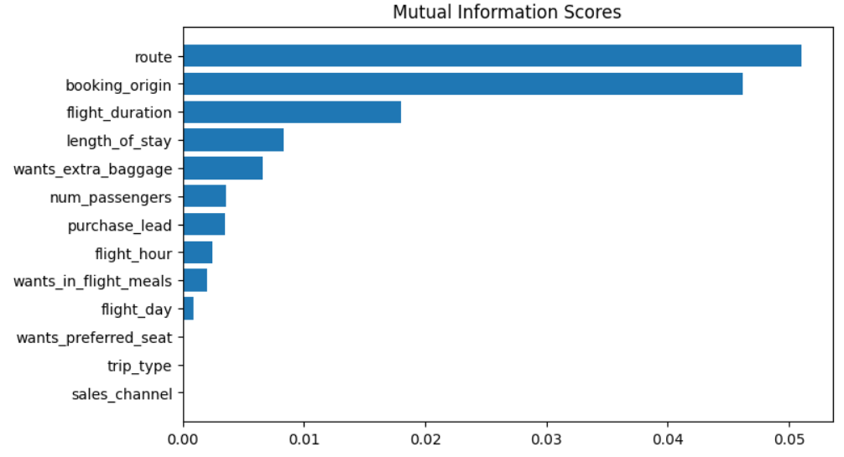
The following models were tested:
From the graph below, we can see that Route, Booking Origin, Flight Duration, Length of Stay, Number of Passengers, and Extra Baggage are the top 6 features which on which the Booking Complete feature depends.
Model 1 : Random forest classifier with top 6 features
ACCURACY: 83.36
AUC score: 0.56578
Model 2: Random forest classifier with all features
ACCURACY: 84.76
AUC score: 0.54796
Model 3: XGB classifier with top 6 features
ACCURACY: 84.87
AUC score: 0.500543
Model 4: XGB classifier with all features
ACCURACY: 84.83
AUC score: 0.50655
Validating Model 2 as final model, as it has good accuracy and higher auc score compared to other models:
ACCURACY: 85.09
AUC score: 0.55778
Conclusion: Model 2 is best, but a higher AUC score is desirable.

